Slide 1
Project III Optimize Content-Centric Networking
TA: Jun-Bin Zhang, Sheng-Hui Peng, An-Fong Li
Office Hour: 15:00 - 18:00 Monday
13:00 - 18:00 Wednesday
At 95522 CPS Lab or LINE or Email
p78083025@ncku.edu.tw
2021.05.05

Slide 2
Outline
Project 3
CCN construction
Format
Test data
Output_interest and Output_data
Process Flow
Coding

Slide 3
1. Project 3
You should optimize this CCN network based on project 2.
1. Add cs.py and fib.py to CCN
interest.py、data.py、forward.py、ps.py、pit.py、cs.py、fib.py ......
2. Creat two tables
Queue、PS、PIT、CS、FIB
Tip:
In Project 3, CS and FIB are used to optimize CCN. That is to say, the interest packet goes to the PS to find whether there is matching content data, and also to the CS to find whether there is matching content data. CS does cache the content data in the data packet.
FIB is recorded routing information of data packet.
When the interest packet needs to be forwarded, it is sent to all its neighbors by broadcasting, and you can read the network to obtain neighbor connection information.

Slide 4
1. Project 3
Optimization
Interest_queue and data_queue
Their storage size is limited. In addition, the router takes the first packet to process each time.
When the queue is full, you need to optimize how to update records. (FIFO, LRU, LFU, etc.)
CS
The cache size of CS is limited. When the CS is full, you need to optimize how to update records. (FIFO, LRU, LFU, Cost-based or Time-based etc.)

Slide 5
1. Project 3
3. Performance evaluation parameters

Slide 6
1. Project 3
3. Test CCN simulator
Input
read 'peremiters、networks、interests、contents of producer' json files.
run your CCN simulator.
Output
real-time output packets information to save in csv files (interest.csv and data.csv).
interest =
["Time"=str(int(time.time()-interest['run_start_time']), "Type"=interest['type'], "Interest_ID"='I'+str(interest['interest_ID']),"Consumer_ID"='C'+str(interest['consumer_ID']), "Route_ID"='R'+str(interest['route_ID']), "Content_name"=interest['content_name'], "Interest_hop"=interest['interest_hop'], "Path"=interest['path'], "Result"='Interest hit in CS', "Hit_cs"=1, "Miss_cs"=0, "interest_number"=0]

Slide 7
1. Project 3
3. Test CCN simulator
Input
read 'peremiters、networks、interests、contents of producer' json files.
run your CCN simulator.
Output
real-time output packets information to save in csv files (interest.csv and data.csv).
data =
["Time"=str(times-data['run_start_time']), "Type"=data['type'], "Consumer_ID"='C'+str(data['consumer_ID']), "Route_ID"='R'+str(data['route_ID']), "Content_name"=data['content_name'], "Data_hop"=data['data_hop'], "Path"=data['path'], "Result"='Data hit in consumer', "Hit_consumer"=1, "Hit_PIT"=1, "Hit_Miss"=0, "response_time"= current_time -interest_start_time]

Slide 8
1. Project 3
Code
python
Upload
2021.06.16 10:00 am upload to moodle
Filename
project3_group1_V1.rar

Slide 9
1. Project 3
DEMO
Time: 2021.06.16
Location: 95522 room
Explain what optimizations you made.
Run your simulator and output the cache hit rate and average response time.

Slide 10
2. Process Flow
output hit
return data
YES
name
hit ?
Router
process interest
Sever
> queue_size
drop interest
interest queue
PS or CS
NO
NO
YES
output miss
router0, ..., router11
life_hop>5 ?
drop interest
PIT
drop interest
output interests
N interests / s
interest
name
packet
type ?
hit ?
YES
mage inface to PIT entry
network
accept
data
NO
Router
process data
name
> queue_size
drop data
PIT
data queue
create a PIT entry
NO
hit ?
YES
drop data
get infaces in PIT entry
Yes consumer
FIB
output hit
FIB
CS
router ID
==
consumerID ?
name
YES
YES
> fib_size
drop
> cs_size
drop
best_route
hit ?
NO
brocast
update ?
cache ?
NO
YES
YES
get min cost outface in FIB entry
add outfaces to PIT entry
get outfaces in FIB entry
update outfaces in FIB entry
cache data in CS entry
forward datas
remove PIT entry
forward interests

Slide 11
3. CCN construction
main.py
sever.py
network.py
ps.py
pit.py
cs.py
fib.py
interest.py
data.py
forward.py

Slide 12
4. Format
Interest packets received by router
interest = {'type': 'interest', 'interest_ID': 0000, 'consumer_ID': 0, 'route_ID': 0, 'content_name': 'r0/00', 'interest_hop': 0, 'life_hop': 5, 'run_start_time': 0, 'path': 'p0/', 'interest_start_time': 0}
You need to add a 'interest_start_time' field in the interest packet
'interest_start_time': The time when the consumer sends out the interest packet. It will be used to calculate the response time for the consumer to receive the data.

Slide 13
4. Format
Data packets received by router
data = {'type': 'data', 'consumer_ID': 0000, 'route_ID': 0, 'content_name': 'r0/00', 'content_data': 'r0/00', 'data_hop': 0, 'run_start_time': 0, 'path': 'p0/', 'interest_start_time': 0, 'data_start_time': 0}
You need to add a 'interest_start_time' and 'data_start_time' field in the data packet
'interest_start_time' = interest['interest_start_time' ]
'data_start_time': The time when the router sends out the interest packet. It is the time when the router that obtained content data created the data packet. It will be used to calculate the travel time of data packet.

Slide 14
4. Format
cs = [[content_name, data, time, cost], ... ]
cs_entry = [content_name, data, time, cost]
fib = {'content_name': [[outface, cost, time], ...], ... }
fib_entry = [[outface, cost, time], ...]
Tip:
CS and FIB will be used in project 3, you must to add its. Each router has these tables independently.
time: The time when the data was recorded in the CS or FIB.
cost: The cost is the data_hop or travel time of the data packet.

Slide 15
4. Format
interest hit in PS or CS
Create a data packet, the format is as follows
data packet =
[[5, {'type': 'data', 'consumer_ID': 0, 'route_ID': 4, 'content_name': 'r4/01', 'content_data': 'r4/011615357625', 'data_hop': 1, 'run_start_time': 1615357618, 'path': 'p4/', 'interest_start_time': 1615357620, 'data_start_time': 1615357634}]]

Slide 16
4. Format
interest miss in PS or CS
Create forwarding interest packets, which may need to be forwarded to multiple outgoing interfaces. The first number of each list is the outgoing interface (router ID). The format is as follows
interest packets =
[[3, {'type': 'interest', 'interest_ID': '0001', 'consumer_ID': 0, 'route_ID': 5, 'content_name': 'r7/07', 'interest_hop': 3, 'life_hop': 5, 'start_time': 1615357599, 'path': 'p0/3/5', 'interest_start_time': 1615357620, 'data_start_time': 1615357634}],
[4, {'type': 'interest', 'interest_ID': '0001', 'consumer_ID': 0, 'route_ID': 5, 'content_name': 'r7/07', 'interest_hop': 3, 'life_hop': 5, 'start_time': 1615357599, 'path': 'p0/3/5', 'interest_start_time': 1615357620, 'data_start_time': 1615357634}],
[5, {'type': 'interest', 'interest_ID': '0001', 'consumer_ID': 0, 'route_ID': 5, 'content_name': 'r7/07', 'interest_hop': 3, 'life_hop': 5, 'start_time': 1615357599, 'path': 'p0/3/5', 'interest_start_time': 1615357620, 'data_start_time': 1615357634}]]

Slide 17
4. Format
data hit in PIT
Create forwarding data packets, which may need to be forwarded to multiple incoming interfaces. The first number of each list is the incoming interface (router ID). The format is as follows
data packets =
[[2, {'type': 'data', 'consumer_ID': 0, 'route_ID': 4, 'content_name': 'r5/09', 'content_data': 'r5/091615357623', 'data_hop': 2, 'start_time': 1615357615, 'path': 'p5/4/', 'interest_start_time': 1615357620, 'data_start_time': 1615357634}],
[6, {'type': 'data', 'consumer_ID': 0, 'route_ID': 4, 'content_name': 'r5/09', 'content_data': 'r5/091615357623', 'data_hop': 2, 'start_time': 1615357615, 'path': 'p5/4/', 'interest_start_time': 1615357620, 'data_start_time': 1615357634}]]

Slide 18
5. Test data
networks
json={
''r0'':[1, 3],
''r1'': [0, 2, 3],
''r2'': [1, 4],
...
''r11'': [7, 10]
}
Tip:
The key is the router ID of string type. The value is a list, and the numbers in the list are the numeric type of the router ID.

Slide 19
5. Test data
parameters
json={"route_num": 12, # number of routers
"frequency": 1, # 1 new interest packet / second sent by each router to network
"content_num": 100, # number of content published by each producer
"run_time": 20, # Simulator running time
"queue_size": 1000, # number of packet stored in the queue
"cache_size": 240, # number of content data stored in cs
"FIB_size": 500} # number of entry stored in the fib
Tip:
In project 3, when the queue is full, the newly received packet is droped.

Slide 20
5. Test data
producer_contents
12 note *100 content =1200 total
json={
"r0": ["r0/0", "r0/1", "r0/2", ..., "r0/98", "r0/99"],
"r1": ["r1/0", "r1/1", "r1/2", ..., "r1/98", "r1/99"],
"r2": ["r2/0", "r2/1", "r2/2", ..., "r2/98", "r2/99"],
...
"r11": ["r11/0", "r11/1", "r11/2", ..., "r11/98", "r11/99"]
}
Tip:
The key is the router ID of string type. The value is a list containing one 100 content names prefixed with its own router ID.

Slide 21
5. Test data
interests
5 interest/s*12 = 60 interest/s 12*100 interest=1200 interests
json={
"r0": [{'interest_ID': 0000,'content_name':'r1/3'}, ...],
"r1": [{'interest_ID': 1000,'content_name':'r9/2'}, ...],
"r2": [{'interest_ID': 2000,'content_name':'r11/8'}, ...],
...
"r11": [{'interest_ID': 1100,'content_name':'r6/7'}, ...]
}
Tip:
The key is the router ID of string type. The value is a list containing one 100 interest packets. Each interest packet is a dictionary containing interest_ID and content_name.

Slide 22
5. Test data
interests
5 interest/s*12 = 60 interest/s 12*100 interest=1200 interests
json={
"r0": [{'interest_ID': 0000,'content_name':'r1/3'}, ...],
"r1": [{'interest_ID': 1000,'content_name':'r9/2'}, ...],
"r2": [{'interest_ID': 2000,'content_name':'r11/8'}, ...],
...
"r11": [{'interest_ID': 1100,'content_name':'r6/7'}, ...]
}
Tip:
interest_ID = routerID + 00-99
content_name is randomly selected from 1200 content published by 12 producers. Therefore, some content names may be repeatedly selected.

Slide 23
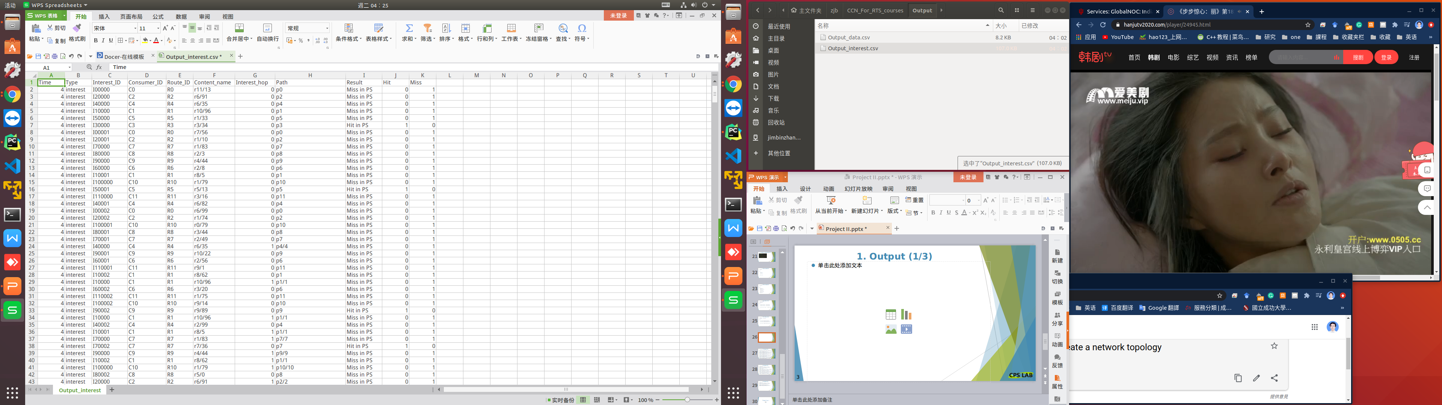
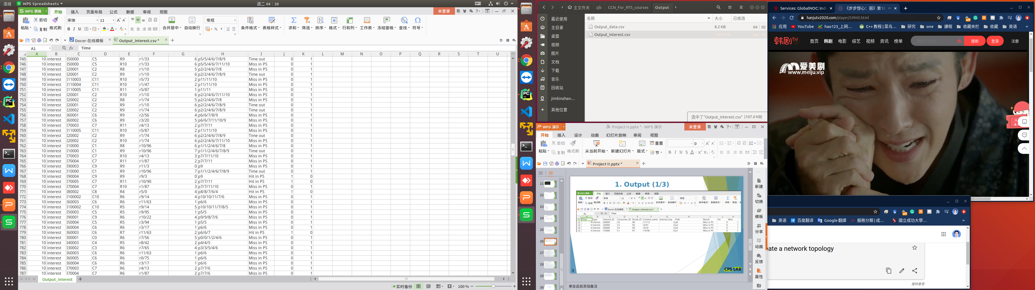
6. Output_interest

Slide 24
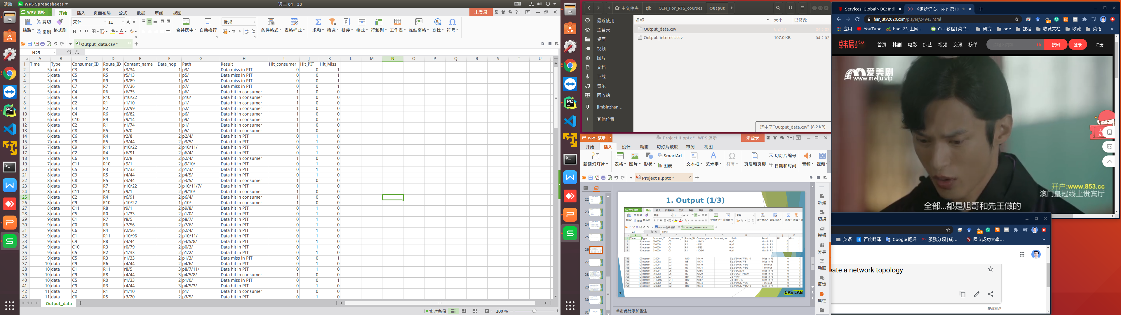
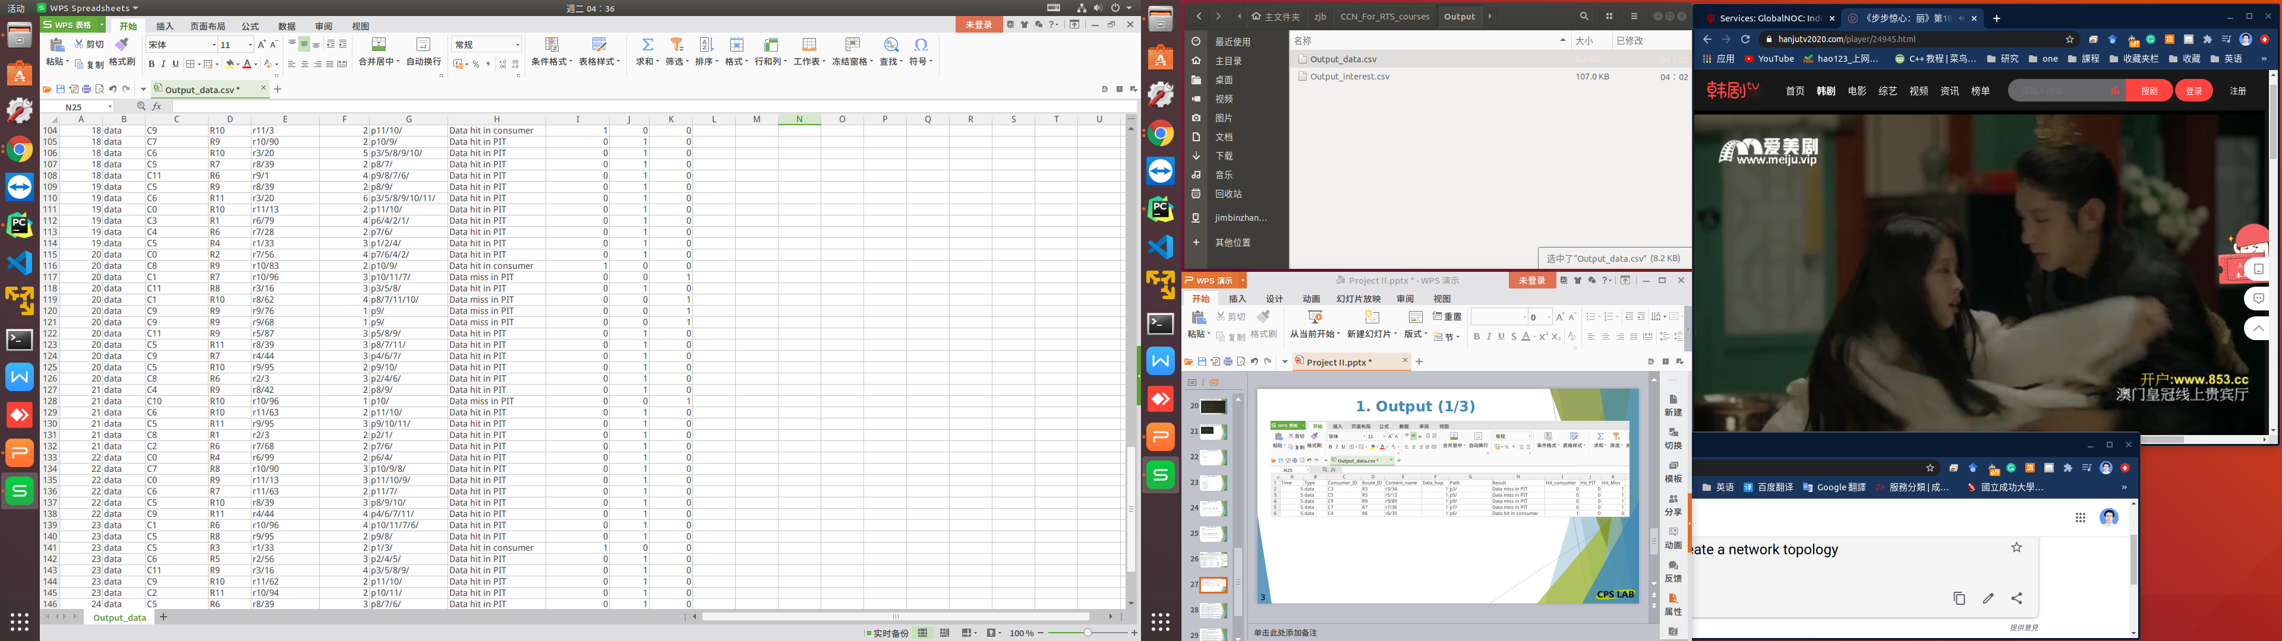
6. Output_data

Slide 25
7. Process Flow
output hit
return data
YES
name
hit ?
Router
process interest
Sever
> queue_size
drop interest
interest queue
PS or CS
NO
NO
YES
output miss
router0, ..., router11
life_hop>5 ?
drop interest
PIT
drop interest
output interests
N interests / s
interest
name
packet
type ?
hit ?
YES
mage inface to PIT entry
network
accept
data
NO
Router
process data
name
> queue_size
drop data
PIT
data queue
create a PIT entry
NO
hit ?
YES
drop data
get infaces in PIT entry
Yes consumer
FIB
output hit
FIB
CS
router ID
==
consumerID ?
name
YES
YES
> fib_size
drop
> cs_size
drop
best_route
hit ?
NO
brocast
update ?
cache ?
NO
YES
YES
get min cost outface in FIB entry
add outfaces to PIT entry
get outfaces in FIB entry
update outfaces in FIB entry
cache data in CS entry
forward datas
remove PIT entry
forward interests

Slide 26
7. Process Flow
Sever
Sever process
The network has 12 node. You can read from the networks JSON file .
networks format
= {'r'+'route_ID': [route_ID, ...], ... }
= {'r1': [0, 2], 'r2': [1, 3, 4], ... }
router0, ..., router11
output interests
N interests / s
network
Each node is both a producer and a consumer.
router ID = consumer ID = 0 1 ... 11
As a producer, router0 will publish the content name with its own router name prefix, for example 'r0/'. Each producer publishes 100 pieces of content, such as 'r0/00-99'. You can read from the producer_contents JSON file .
producer_contents format
= {'r'+'route_ID': [content_name, ...], ... }
= {'r0': ['r0/00', 'r0/01', ..., 'r0/99'], 'r1': ['r1/00', 'r1/01', ..., 'r1/99'], ... }

Slide 27
7. Process Flow
Sever
Sever process
As a consumer, router1can send out interest packet to request any content name with a router name prefix, such as 'r1/88'.
All routers simultaneously send out N new interests / s to the network.
router0, ..., router11
output interests
N interests / s
network
N = frequency. You can read from the parameters and interests JSON file based on the router name. interests has only interest_ID and content name. You need to fill in other information according to the complete format of the interest.
interests format
={"r0": [{'interest_ID': 0000,'content_name':'r1/3'}, ...], "r1": [{'interest_ID': 1000,'content_name':'r9/2'}, ...], ... "r11": [{'interest_ID': 1100,'content_name':'r6/7'}, ...]}
interest format
= {'type': 'interest', 'interest_ID': 0000, 'consumer_ID': 0, 'route_ID': 0, 'content_name': 'r0/00', 'interest_hop': 0, 'life_hop': 5, 'run_start_time': 0.0, 'path': 'p0/', 'interest_start_time': 1615357620, 'data_start_time': 1615357634}

Slide 28
7. Process Flow
Sever
Sever process
You need to output the number of interest packets sent by each consumer. So that you can calculate the average response time.
router0, ..., router11
output interests
N interests / s
network
Interest Output.CSV format
= [
"Time"=str(int(time.time()-interest['run_start_time']), "Type"=interest['type'], "Interest_ID"='I'+str(interest['interest_ID']), "Consumer_ID"='C'+str(interest['consumer_ID']), "Route_ID"='R'+str(interest['route_ID']), "Content_name"=interest['content_name'], "Interest_hop"=interest['interest_hop'], "Path"=interest['path'],"Result"='Send Interest by Consumer', "Hit_cs"=0,"Miss_cs"=0, "interest_number"=5, "response_time"=0
]

Slide 29
7. Process Flow
Sever
Sever process
Get N in turn from the interests belonging to this router. And package them start_packets, and then hand them to the server to send them to the network.
router0, ..., router11
output interests
N interests / s
network
Interest packets format sent by consumer
start_packets
= [{'type': 'interest', 'interest_ID': '0300', 'consumer_ID': 3, 'route_ID': 3, 'content_name': 'r7/01', 'interest_hop': 0, 'life_hop': 5, 'run_start_time': 1615357629, 'path': 'p3/', 'interest_start_time': 1615357620, 'data_start_time': 1615357634},
.....
{'type': 'interest', 'interest_ID': '0304', 'consumer_ID': 3, 'route_ID': 3, 'content_name': 'r11/8', 'interest_hop': 0, 'life_hop': 5, 'run_start_time': 1615357629, 'path': 'p3/', 'interest_start_time': 1615357620, 'data_start_time': 1615357634}]

Slide 30
7. Process Flow
Sever
Sever process
When the accept receives a packet, it needs to read the type of packet and determine whether it is interest or data.
router0, ..., router11
output interests
N interests / s
packet
type ?
network
accept
data
> queue_size
drop data
data queue
If it is a data packet, you need to determine whether the data_queue size is greater than the queue_size. You can read the queue_size from the parameter JSON file.
If it is YES, it indicates that the data_queue is full, and the received packet is droped and not stored in the data_queue.
If NO, then store the received packet in the data_queue.
Their storage size is limited. In addition, the router takes the first packet to process each time.
When the queue is full, you need to optimize how to update records. (FIFO, LRU, LFU, etc.)

Slide 31
7. Process Flow
Sever
> queue_size
drop interest
interest queue
NO
Sever process
If it is a interest packet, you need to read the life_hop from the packet.
Then see if it is greater than 5. If YES, then drop the interest packet. Because we set an interest packet to have a life cycle of only 5 hops in the network.
life_hop>5 ?
YES
router0, ..., router11
drop interest
output interests
N interests / s
interest
packet
type ?
network
accept
data
> queue_size
drop data
data queue
If NO, you need to determine whether the interest_queue size is greater than the queue_size. You can read the queue_size from the parameter JSON file.
If it is YES, it indicates that the interest_queue is full, and the received packet is droped and not stored in the interest_queue.
If NO, then store the received packet in the interest_queue.
Their storage size is limited. In addition, the router takes the first packet to process each time.
When the queue is full, you need to optimize how to update records. (FIFO, LRU, LFU, etc.)

Slide 32
7. Process Flow
interest queue
Sever
> queue_size
drop interest
NO
Sever process
After the simulator runs for a fixed period of time, it exits. You can read run_time from the parameters JSON file.
The server monitors whether a packet is received in real time.
The router takes the first packet from the interest_queue and data_queue for processing each time.
life_hop>5 ?
YES
router0, ..., router11
drop interest
output interests
N interests / s
interest
packet
type ?
network
accept
data
> queue_size
drop data
data queue

Slide 33
7. Process Flow
return data
output hit
interest (name)
YES
hit ?
Router
process interest
interest queue
ps or cs
Interest process
The router takes the first packet from the interest_queue for processing each time.
The router gets name from packet. Go to ps (producer store) to find if there is matching data.
ps stores 100 content published by each producer, such as 'r0/00-99'. You can read from the producer_contents JSON file.
ps format
= [content_name, ...]
If it hits, data packet is returned.

Slide 34
7. Process Flow
return data
output hit
interest (name)
YES
hit ?
Router
process interest
interest queue
ps or cs
Interest process
If it miss, go to cs (cache store) to find if there is matching data. cs can cache the content data of data packet.
cs format
= [[content_name, data, time, cost], ... ]
cs_entry
= [content_name, data, time, cost]
time: The time when the data was recorded in the CS.
cost: It is the data_hop or travel time of the data packet.
If it hits, data packet is returned.

Slide 35
7. Process Flow
return data
output hit
interest (name)
YES
Interest process
Create a data packet.
data packet format
= [[5, {'type': 'data', 'consumer_ID': 0, 'route_ID': 9, 'content_name': 'r9/01', 'content_data': 'content_name' + str(current time), 'data_hop': 1, 'run_start_time': 1615357618, 'path': 'p9/', 'interest_start_time': 0, 'data_start_time': 0}]]
The first element 5 of the list represents the incoming interface (it is router_ID in interest) of the interest.
The second element of the list is a dictionary, which represents a data packet.
content_data format
= 'content_name' + str(current time)
'interest_start_time' = interest['interest_start_time']
'data_start_time' = str(current time)
hit ?
Router
process interest
interest queue
ps or cs

Slide 36
7. Process Flow
return data
output hit
interest (name)
YES
hit ?
Router
process interest
interest queue
ps or cs
Interest process
Output 'Interest hit in CS' to CSV.
Interest Output.CSV format
= ["Time"=str(int(time.time()-interest['run_start_time']), "Type"=interest['type'],
"Interest_ID"='I'+str(interest['interest_ID']), "Consumer_ID"='C'+str(interest['consumer_ID']), "Route_ID"='R'+str(interest['route_ID']),
"Content_name"=interest['content_name'],
"Interest_hop"=interest['interest_hop'], "Path"=interest['path'],
"Result"='Interest hit in CS',
"Hit_cs"=1, "Miss_cs"=0,
"interest_number"=0]

Slide 37
7. Process Flow
return data
output hit
interest (name)
YES
hit ?
Router
process interest
interest queue
ps or cs
Interest process
If miss in cs, output 'Interest miss in CS' to CSV. The format following above.
And go to pit to find a matching entry by content_name.
pit format
= {'content_name': [[inface, ...], [outface, ...]], ... }
PIT_entry format
= [[inface, ...], [outface, ...]]
output miss
NO
pit
drop interest
name
hit ?
YES
mage inface to PIT_entry

Slide 38
7. Process Flow
return data
output hit
interest (name)
YES
hit ?
Router
process interest
interest queue
ps
Interest process
If it hits, it means that the interest requesting the same content name has been received and forwarded, and this interest only needs to wait for data to return. So merge the incoming interface (it is router_ID in interest) into the inface of entry.
PIT_entry format
= [[inface, ...], [outface, ...]]
You may want to check to make sure that there is no duplicate inface in PIT_entry .
And then drop the interest. The router takes a data packet from the data_queue for processing.
output miss
NO
pit
drop interest
name
hit ?
YES
mage inface to pit_entry

Slide 39
7. Process Flow
return data
output hit
interest (name)
YES
hit ?
Router
process interest
interest queue
ps
Interest process
If content name miss in pit, create a new entry in pit to record the content name and inface (it is router_ID in interest).
PIT_entry
= [[inface], []]
pit
= {... , 'content_name': [[inface], []]}
output miss
NO
pit
drop interest
name
hit ?
YES
mage inface to PIT_entry
NO
create a PIT_entry

Slide 40
7. Process Flow
return data
output hit
interest (name)
YES
hit ?
Router
process interest
interest queue
ps
Interest process
Then, go to FIB to find if there is an entry that matches the content name.
If NO, broadcast the interest to all neighbors.
Otherwise, choose the best_route strategy.That is, from the outgoing interfaces of the matched entry, the outface with the lowest cost is selected to forward the interest packet.
fib format
= {'content_name': [[outface, cost, time], ...], ... }
fib_entry format
= [[outface, cost, time], ...]
output miss
NO
pit
drop interest
name
hit ?
YES
mage inface to PIT_entry
NO
create a PIT_entry
FIB
name
YES
hit ?
NO
best_route
brocast
get min cost outface in FIB entry
get outfaces in FIB entry

Slide 41
7. Process Flow
return data
output hit
interest (name)
YES
hit ?
Router
process interest
interest queue
ps
Interest process
And record these outgoing interfaces in the outface of the matching entry in pit.
PIT_entry
= [[inface], [outface, ...]]
pit
= {... , 'content_name': [[inface], [outface, ...]]}
output miss
NO
pit
drop interest
name
hit ?
YES
mage inface to PIT_entry
NO
create a PIT_entry
FIB
name
YES
hit ?
NO
best_route
brocast
get min cost outface in FIB entry
add outfaces to PIT entry
get outfaces in FIB entry
forward interests

Slide 42
7. Process Flow
return data
output hit
interest (name)
YES
hit ?
Router
process interest
interest queue
ps
Interest process
interest miss in ps
Create forwarding interest packets, which may need to be forwarded to multiple output interfaces. The first number of each list is the outface (router ID).
interest packets format
=[[7, {'type': 'interest', 'interest_ID': '0001', 'consumer_ID': 0, 'route_ID': 5, 'content_name': 'r7/07', 'interest_hop': 3, 'life_hop': 5, 'run_start_time': 1615357599, 'path': 'p0/3/5', 'interest_start_time': 0, 'data_start_time': 0}], [4, {'type': 'interest', 'interest_ID': '0001', 'consumer_ID': 0, 'route_ID': 5, 'content_name': 'r7/07', 'interest_hop': 3, 'life_hop': 5, 'run_start_time': 1615357599, 'path': 'p0/3/5', 'interest_start_time': 0, 'data_start_time': 0}], [8, {'type': 'interest', 'interest_ID': '0001', 'consumer_ID': 0, 'route_ID': 5, 'content_name': 'r7/07', 'interest_hop': 3, 'life_hop': 5, 'run_start_time': 1615357599, 'path': 'p0/3/5', 'interest_start_time': 0, 'data_start_time': 0}]]
The interest packets is forwarded by the server.
output miss
NO
pit
drop interest
name
hit ?
YES
mage inface to PIT_entry
NO
create a PIT_entry
FIB
name
YES
hit ?
NO
best_route
brocast
get min cost outface in FIB entry
add outfaces to PIT entry
get outfaces in FIB entry
forward interests

Slide 43
7. Process Flow
data
name
Router
process data
PIT
data queue
Data process
The router takes the first packet from the data_queue for processing each time.
The router gets name from packet. Go to pit to find if there is matching name.
pit format
= {'content_name': [[inface, ...], [outface, ...]], ... }
If it miss, data is droped. The router takes a interest packet from the interest_queue for processing.
NO
hit ?
drop data

Slide 44
7. Process Flow
data
name
Router
process data
PIT
data queue
Data process
At the same time, check whether the FIB is full. If FIB is smaller than fib_size, then update the content name and routing information (outface) to the FIB.
fib format
= {'content_name': [[outface, cost, time], ...], ... }
fib_entry format
= [[outface, cost, time], ...]
time = 'data_start_time'
cost = current_time - interest_start_time
NO
hit ?
drop data
FIB
> fib_size
drop
update ?
YES
update outfaces in FIB entry

Slide 45
7. Process Flow
data
name
Router
process data
PIT
data queue
Data process
Otherwise, it means that this is the first data returned for this name. Get the incoming interfaces from the PIT_entry.
pit format
= {'content_name': [[inface, ...], [outface, ...]], ... }
PIT_entry format
= [[inface, ...], [outface, ...]]
NO
hit ?
YES
drop data
get infaces in PIT entry
Yes consumer
FIB
router ID
==
consumerID ?
YES
> fib_size
drop
update ?
output hit
YES
update outfaces in FIB entry
Determine whether the current router_ID is equal to the consumer_ID in the data packet. If YES, it means that the consumer has received a data response.

Slide 46
7. Process Flow
data
name
Router
process data
PIT
data queue
Data process
Data Output.CSV format
=["Time"=str(times-data['run_start_time']), "Type"=data['type'], "Consumer_ID"='C'+str(data['consumer_ID']), "Route_ID"='R'+str(data['route_ID']), "Content_name"=data['content_name'], "Data_hop"=data['data_hop'], "Path"=data['path'], "Result"='Data hit in consumer', "Hit_consumer"=1, "Hit_PIT"=1, "Hit_Miss"=0, "response_time"= current_time -interest_start_time]
NO
hit ?
YES
drop data
get infaces in PIT entry
Yes consumer
FIB
router ID
==
consumerID ?
YES
> fib_size
drop
update ?
output hit
YES
update outfaces in FIB entry

Slide 47
7. Process Flow
data
name
Router
process data
PIT
data queue
Data process
Remove this content_name record from pit.
Otherwise, forward the data packet to all routers on the incoming interface and remove this content_name record from pit.
pit format
= {'content_name': [[inface, ...], [outface, ...]], ... }
NO
hit ?
YES
drop data
get infaces in PIT entry
Yes consumer
FIB
router ID
==
consumerID ?
YES
> fib_size
drop
update ?
output hit
NO
YES
update outfaces in FIB entry
forward datas
remove PIT entry

Slide 48
7. Process Flow
data
name
Router
process data
PIT
data queue
Data process
data hit in pit
Create forwarding data packets, which may need to be forwarded to multiple incoming interfaces. The first number of each list is the incoming interface (next router ID).
NO
hit ?
YES
drop data
get infaces in PIT entry
Yes consumer
FIB
router ID
==
consumerID ?
YES
> fib_size
drop
update ?
output hit
NO
YES
update outfaces in FIB entry
forward datas
remove PIT entry
data packets format
= [[2, {'type': 'data', 'consumer_ID': 0, 'route_ID': 4, 'content_name': 'r5/09', 'content_data': '', 'data_hop': 2, 'run_start_time': 1615357615, 'path': 'p5/4/', 'interest_start_time': 1615357620, 'data_start_time': 1615357634}],
[6, {'type': 'data', 'consumer_ID': 0, 'route_ID': 4, 'content_name': 'r5/09', 'content_data': '', 'data_hop': 2, 'run_start_time': 1615357615, 'path': 'p5/4/', 'interest_start_time': 1615357620, 'data_start_time': 1615357634}]]
The data packets is forwarded by the server.

Slide 49
7. Process Flow
data
name
Router
process data
PIT
data queue
Data process
At the same time, check whether the CS is full. If CS is smaller than cs_size, then cache the content data to the CS.
The cache size of CS is limited. When the CS is full, you need to optimize how to update records. (FIFO, LRU, LFU, Cost-based or Time-based etc.)
cs format
= [[content_name, data, time, cost], ... ]
cs_entry format
= [content_name, data, time, cost]
time = 'data_start_time'
cost = current_time - interest_start_time
NO
YES
drop data
hit ?
get infaces in PIT entry
Yes consumer
FIB
CS
router ID
==
consumerID ?
YES
> fib_size
drop
> cs_size
drop
update ?
cache ?
output hit
NO
YES
YES
update outfaces in FIB entry
cache data in CS entry
forward datas
remove PIT entry

Slide 50
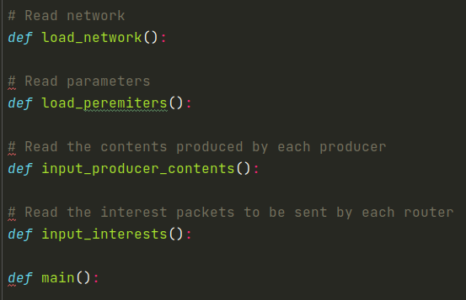
8. Coding----main.py
Network is a dict.
key = router name ex. 'r0'
value = [router ID, ...] ex. [1, 3]
Peremiters is a dict.
key = Peremiter name ex.'route_num'
value = Peremiter value ex. 12
Producer contents is a dict.
key = Producer ID ex. 'p1'
value = [Content name, ...] ex. ['r1/0', 'r1/99']
Interests is a dict.
key = router ID ex. 'r1'
value = [{'interest ID': , 'Content name': }, ...] ex. [{'interest ID': 0001, 'Content name': 'r1/99'}]
Initialization parameters
Get the time when the simulator started running run_start_time
Build a server for each router
At regular intervals（frequency） in the while loop, all routers send out new interest packets to the network. At the same time, it keeps checking whether the simulator end time is up.

Slide 51
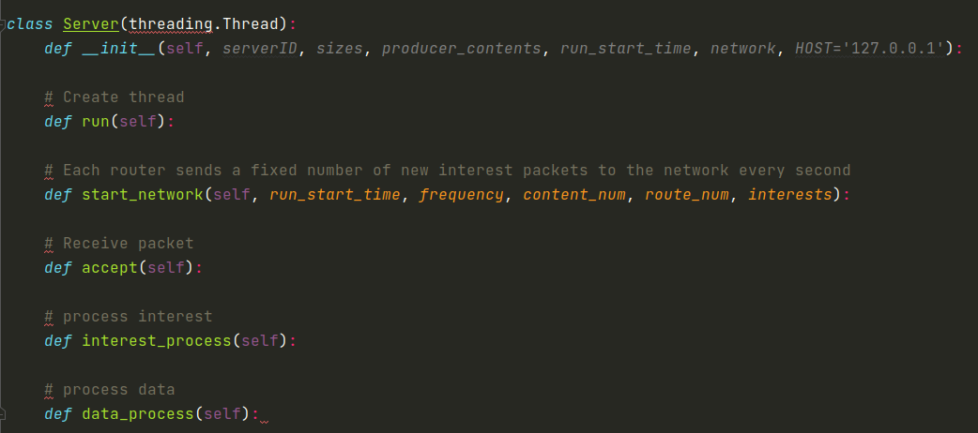
8. Coding----server.py
create a accept thread
create a interest_process thread
create a data_process thread
The router sends a new interest packet to the network.
Monitor whether a packet is received. If packet is received, read the packet type to determine whether it is interest or data packet. Then store the packet in the corresponding queue. At this time, to determine whether queue is full. If it is full, drop this packet, otherwise save it.
The router takes the first interest packet from interest_queue for processing
The router takes the first data packet from data_queue for processing

Slide 52
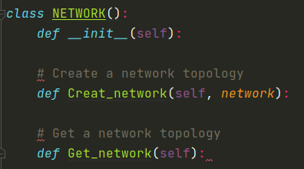
8. Coding----network.py
Create a network dictionary.
Create a network dictionary, assign the network dictionary read from the networks JSON file to it, and return this dictionary.
return network dictionary.

Slide 53
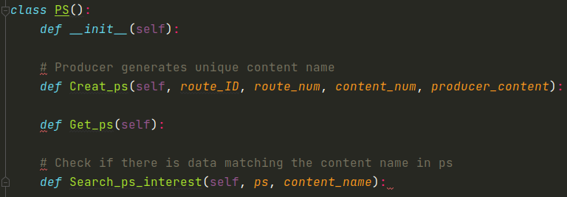
8. Coding----ps.py
Create an empty ps list.
Store the producer contents of the current router read from the producer content JSON file into ps list of router.
return ps list of router.
get the content name from the interest packet, and look for matching data in ps. If it matches, return TRUE, otherwise return FALSE.

Slide 54
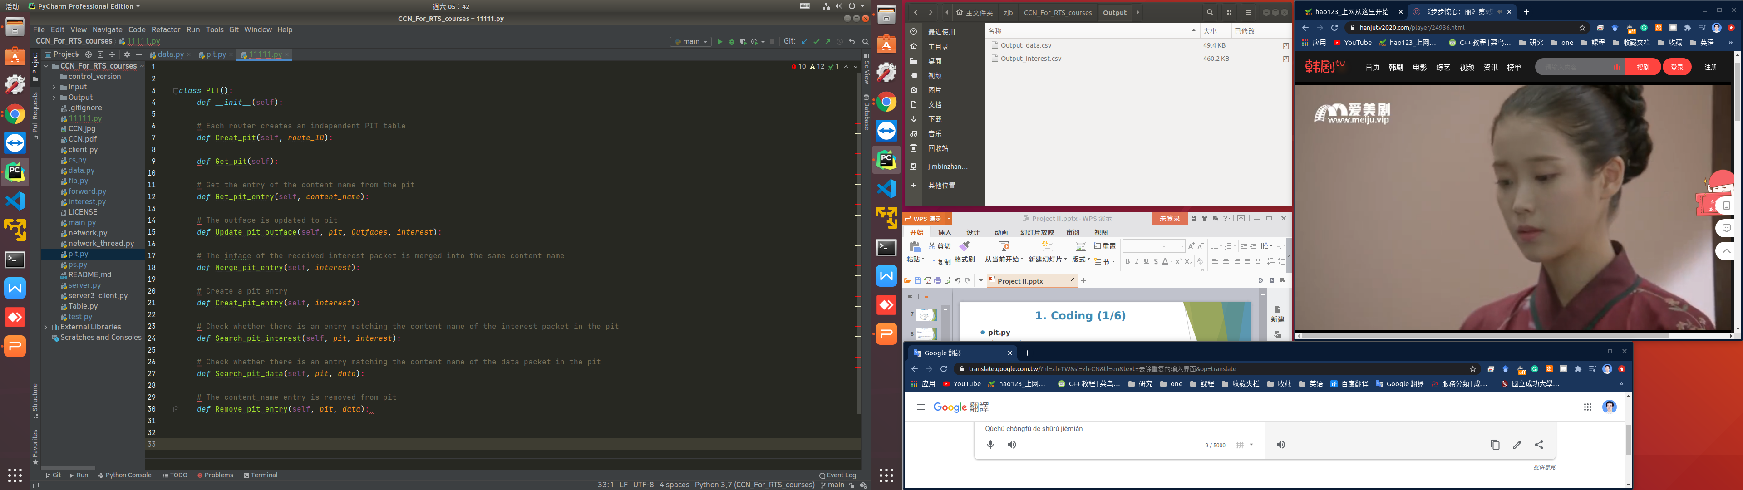
8. Coding----pit.py
Create an empty pit dictionary.
return an pit dictionary.
return an pit dictionary.
Get the value (PIT_entry list) from the pit dictionary with the content name as the key and return it.
Get the value (PIT_entry list) from the pit dictionary with the content name as the key. Add the outfaces to the outface of the PIT_entry list.
Get the value (PIT_entry list) from the pit dictionary with the content name as the key. Merge the inface (route_ID of interest) to the inface of the PIT_entry list. At the same time, make sure that the inface is not repeated in inface of the PIT_entry list.

Slide 55
8. Coding----pit.py
Create a PIT_entry in the pit dictionary with the content name. Add the inface (route_ID of interest) to the inface of the PIT_entry.
Get content name from the interest. Check matching PIT_entry in pit. If it matches, merge incoming interface (route_ID of interest) into inface of PIT_entry and return FALSE. Otherwise create a new PIT_entry in pit and return TRUE.
Get the content name from the data packet. Check matching PIT_entry in pit. If it matches, return TRUE. Otherwise return FALSE.
Get the content name from the data packet. Check matching PIT_entry in pit. If it matches, return TRUE. Otherwise return FALSE.

Slide 56
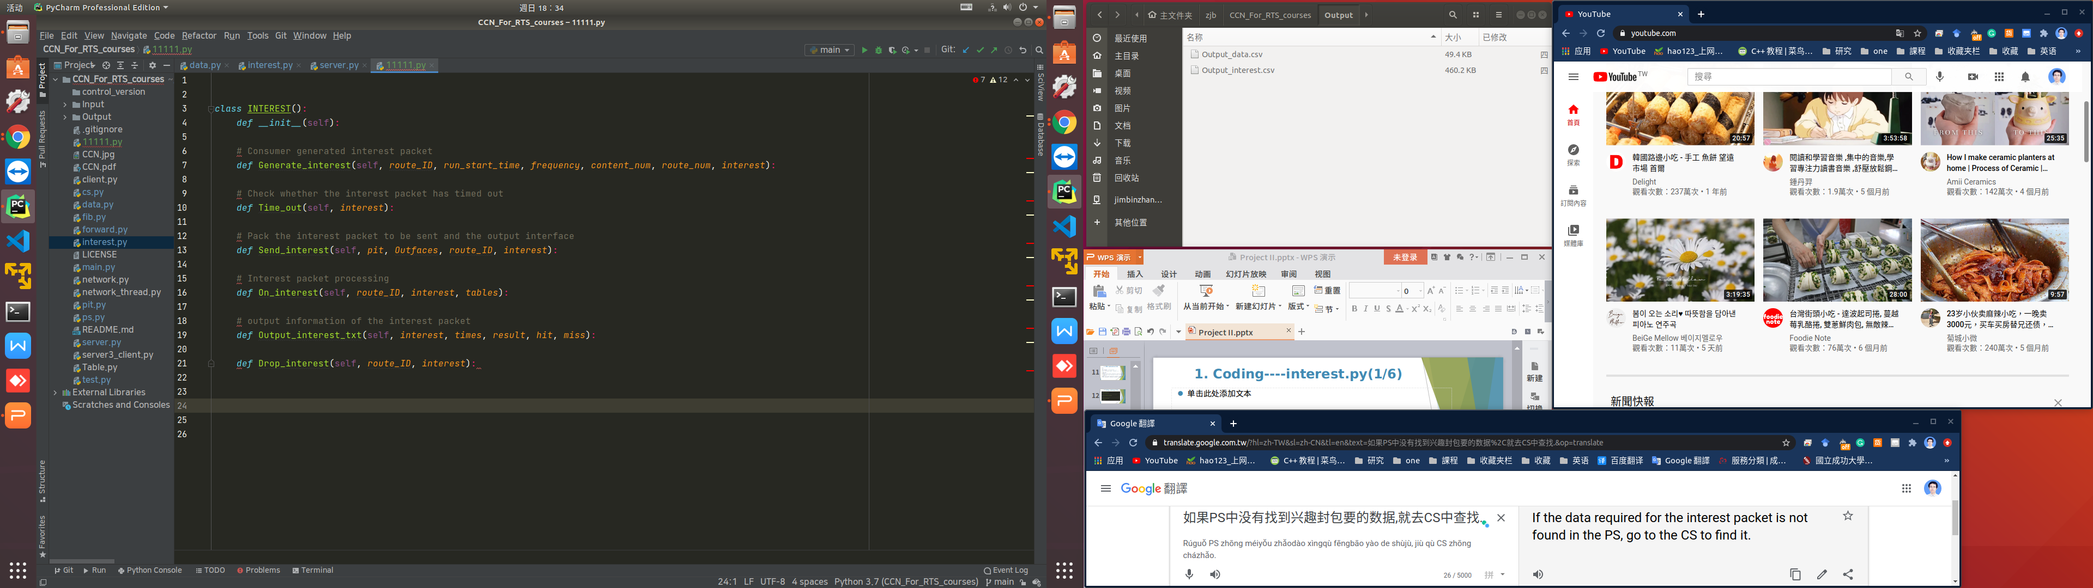
8. Coding----interest.py
Create a interest dictionary.
Get N new interest packets belonging to this router from the interest JSON file. And reconstruct it according to the complete interest packet format. Note that the life_hop is set to 5. Pack them in a list and return.
Determine whether the interest_hop of the interest is greater than the life_hop. If yes, return an error and drop the interest , without recording it in the interest_queue.
Pack interests to be forwarded into a list according to the outfaces. The interest_hop is added by 1, and the path of interest is added to the current router ID. At the same time, the outfaces is updated to the PIT_entry matching content_name.

Slide 57
8. Coding----interest.py
Get content name from the interest packet. Check if there is matching data in ps. If there is a match, create a data packet. Then output the information that the ''interest hits in ps'' to CSV and return the data packet.
Otherwise, output the information that the “interest miss in ps” to interest.CSV.
Output interest packet information and write to interest.CSV
Output the information of interest packet and write it to interest.CSV

Slide 58
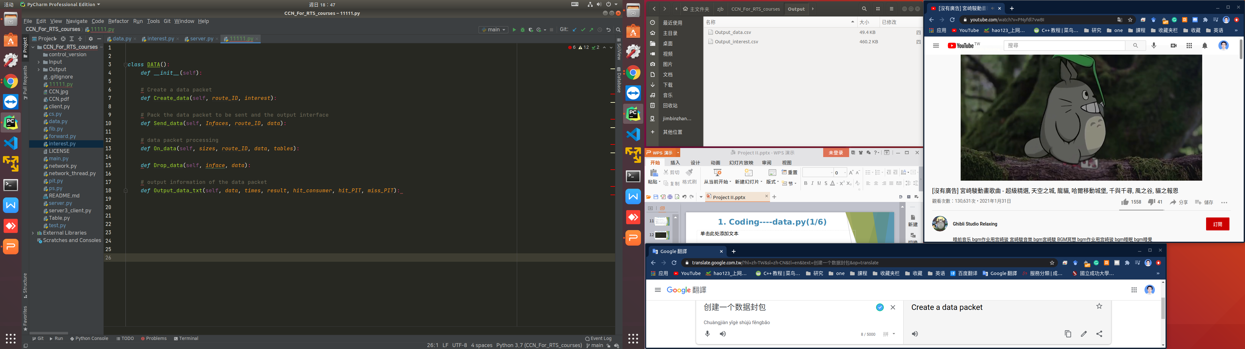
8. Coding----data.py
Create a data packet dictionary.
Create a data packet according to the complete data packet format. The content data is a random number ranging from 0 to 100,000.
Pack datas to be forwarded into a list according to the infaces. The data_hop is added by 1, and the path of data is added to the current router ID.
Get content name from the data packet. Check if there is matching data in pit. If there is a match, then check whether the router ID is the same as the consumer ID. If yes, output the information that the “data hit in consumer” to data.CSV.
Otherwise, output the information that the “data hit in pit” to data.CSV and forward data packet.
If not match in pit, output the information that the “data miss in pit” to data.CSV.

Slide 59
8. Coding----data.py
Output the drop information of data packet and write it to data.CSV
Output the information of data packet and write it to data.CSV

Slide 60
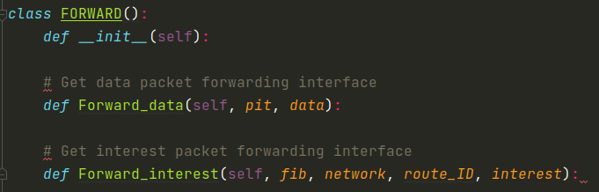
8. Coding----forward.py
Get the inface (router ID) from the data packet. Get the PIT_entry matching the content name from the pit. Then pack the infaces of the PIT_entry except for the same as the inface into the Infaces, and return it.
Prevent data packet from being transmitted back to the previous router.
Get the inface (router ID) from the inteseat packet. Get the FIB_entry matching the router ID from the network. Then pack the outfaces of the FIB_entry except for the same as the inface into the Outfaces, and return it.
Prevent interest packet from being transmitted back to the previous router.

Slide 61
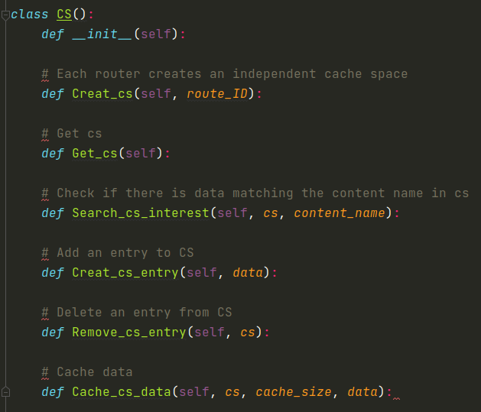
8. Coding----cs.py
Create a CS list
Return a CS list
Return a CS list
Go through each entry in CS and check if there is a matching content name. If it is matched, return Ture. Otherwise, return False.
Get the content name and data, and data_start_time, data_hop from the data packet. Create a new CS entry, record them in this entry.
Sort CS by cost or time. Delete the most cost or earliest recorded entry.
Determine whether the CS size > cache_size. If not, then create a cs entry to cache content data. Otherwise, delete an entry from CS, and then create a new entry to cache content data.

Slide 62
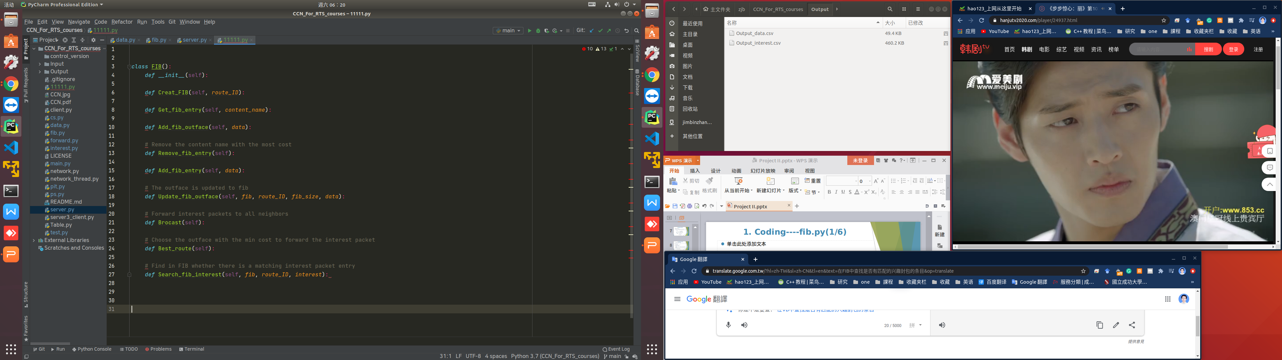
8. Coding----fib.py
Create a fib dictionary and a list of fib_entry.
Return a fib dictionary.
Return a fib entry that matches the content name.
Get the outface, data_start_time and data_hop from the data packet. Check whether FIB is full. If not, update content name and routing information to FIB entry, and re-sort FIB, putting the lowest cost first. Otherwise, remove an outface from FIB entry, and update content name and routing information to FIB entry.
Remove the most costly content name or the longest time content name from FIB.
Add content name and outface to FIB dictionary.

Slide 63
8. Coding----fib.py
Get fib entry from FIB based content name, if there is an entry that matches content name. Check whether FIB is full. If it is full, remove an entry from FIB, and then add a new entry to record content name.
Get the neighbor router outface connected to this router, except the router that received theinterest packet.
Get the lowest cost outface from FIB entry.
Check whether there is an entry in FIB that matches the content name of interest packet. If not, then select the broadcast strategy to forward the interest packet. Otherwise, the outface with the lowest cost is selected from the matched entry to forward the interest packet.

Slide 64
Thank You !
Q&A
Email：P780083025@ncku.edu.tw

